Slide 1
Recurrent Neural Networks (RNNs)
Deep Learning
Notes:
Welcome to the topic of Recurrent Neural Networks, a fundamental component of deep learning. Today, we'll explore the architecture, variants, and applications of RNNs. Ask students if they have any prior knowledge of neural networks.

Slide 2
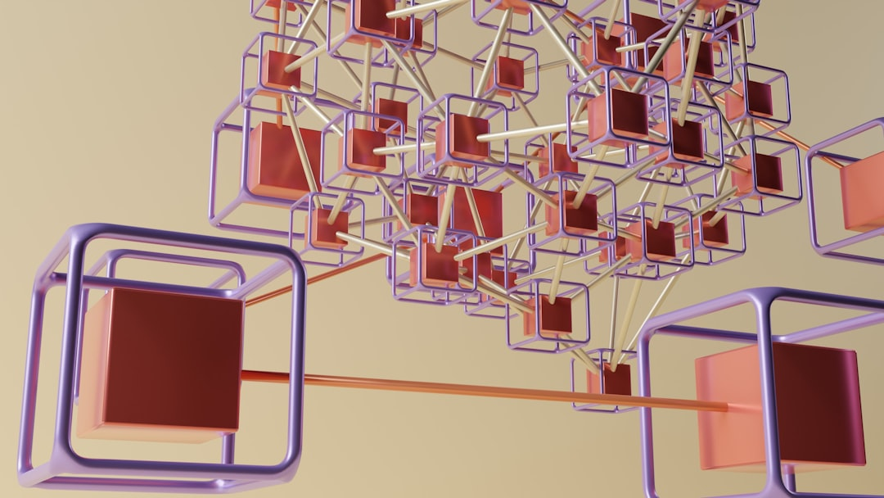
Intro/Background
RNNs process sequential data
Used in speech recognition, language modeling
Can learn long-term dependencies
Handle variable-length inputs
Key to natural language processing
Time-series forecasting applications
Image captioning and machine translation
RNNs are a type of neural network
Inspired by human brain structure
Notes:
Explain that RNNs are designed to handle sequential data, which is essential for many real-world applications. Provide examples such as speech recognition and language modeling. Ask students to think about how RNNs can be used in their own projects.

Slide 3
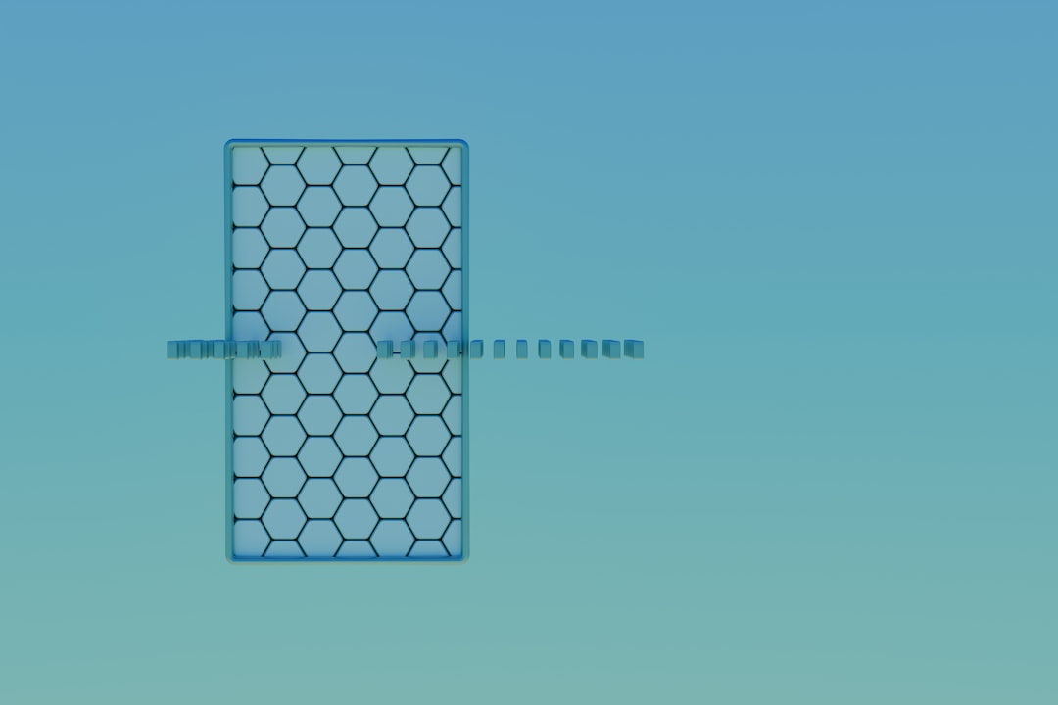
Architecture & Key Equation
Image query: RNN architecture diagram
Simple RNN equation: h_t = tanh(Wx_t + Uh_{t-1})
Input gate, output gate, and cell state
Backpropagation through time (BPTT)
Vanishing gradients and exploding gradients
RNNs can be trained using stochastic gradient descent
Regularization techniques to prevent overfitting
Initialization of weights and biases
Notes:
Show the RNN architecture diagram and explain the key components, including the input gate, output gate, and cell state. Write the simple RNN equation on the board and explain its significance. Discuss the challenges of training RNNs, such as vanishing gradients and exploding gradients.

Slide 4
Variants
LSTM (Long Short-Term Memory) networks
GRU (Gated Recurrent Unit) networks
Bidirectional RNNs for sequential data
Deep RNNs with multiple hidden layers
Residual connections for deeper RNNs
Attention mechanisms for focused processing
Recurrent Highway Networks (RHNs)
Clockwork RNNs for multi-scale processing
Notes:
Introduce the variants of RNNs, including LSTMs and GRUs, and explain their advantages and disadvantages. Provide examples of how these variants can be used in different applications. Ask students to consider which variant would be most suitable for a given problem.

Slide 5
Applications + Advantages/Limitations
Speech recognition and speech synthesis
Language modeling and text generation
Machine translation and language understanding
Time-series forecasting and prediction
Image captioning and visual question answering
Advantages: handling sequential data
Limitations: vanishing gradients and overfitting
RNNs can be computationally expensive
Requires large amounts of training data
Notes:
Discuss the various applications of RNNs, including speech recognition and language modeling. Explain the advantages of using RNNs, such as their ability to handle sequential data. Also, discuss the limitations of RNNs, including vanishing gradients and overfitting. Ask students to think about how RNNs can be improved for real-world applications.

Slide 6
Summary
RNNs process sequential data
Variants: LSTMs, GRUs, and bidirectional RNNs
Applications: speech recognition, language modeling
Advantages: handling sequential data
Limitations: vanishing gradients and overfitting
Real-world applications: time-series forecasting
Importance of regularization and initialization
Future directions: attention mechanisms and deep RNNs
Notes:
Summarize the key takeaways from the lecture, including the architecture, variants, and applications of RNNs. Emphasize the importance of handling sequential data and the challenges of training RNNs. Ask students to reflect on what they have learned and how they can apply it to their own projects. Provide additional resources for further learning.

